Slide 1
Git bash
commands

Slide 2
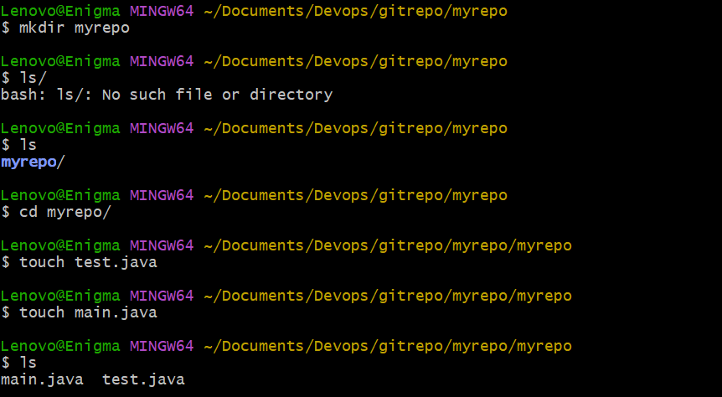

Slide 3
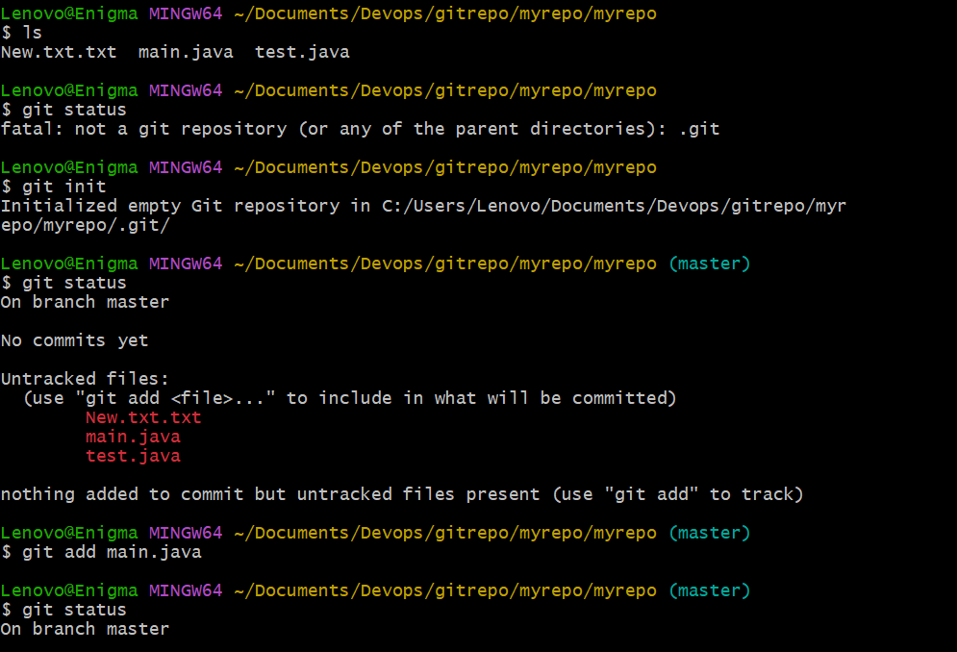

Slide 4
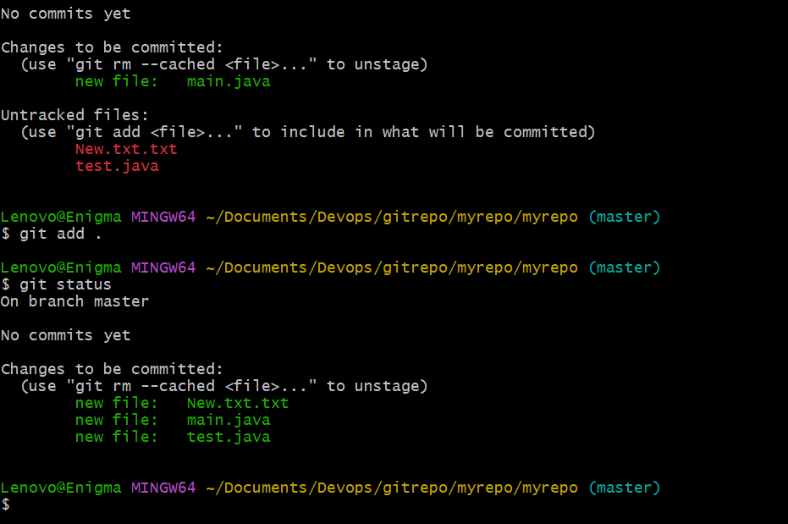

Slide 5
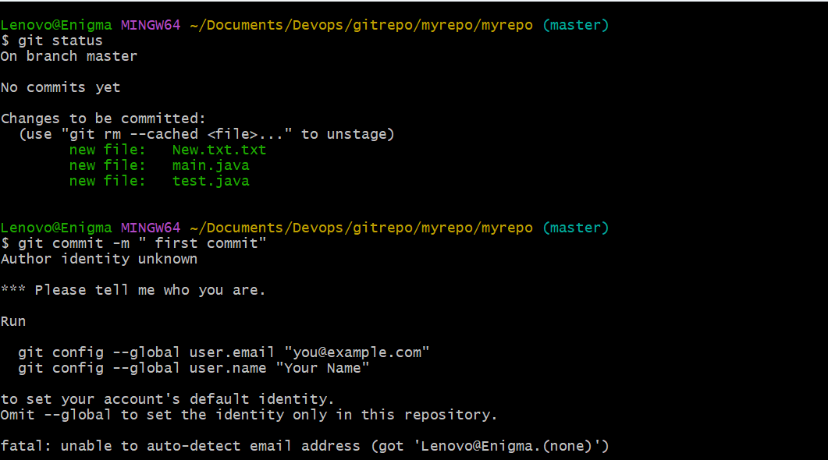

Slide 6
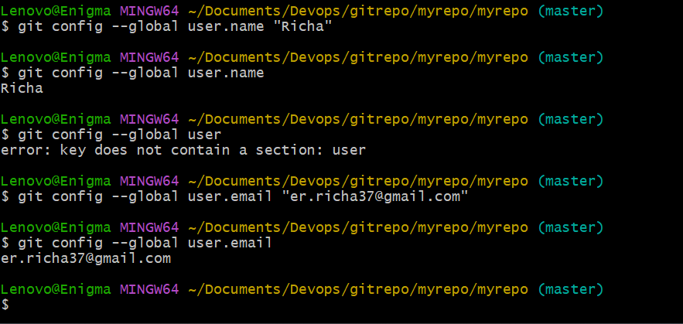

Slide 7


Slide 8
Login to git hub and create new repository with name my repo
Don’t go for read me or any other option
See the url of your repository
Just copy the url : https://github.com/Richa736/myrepo.git

Slide 9
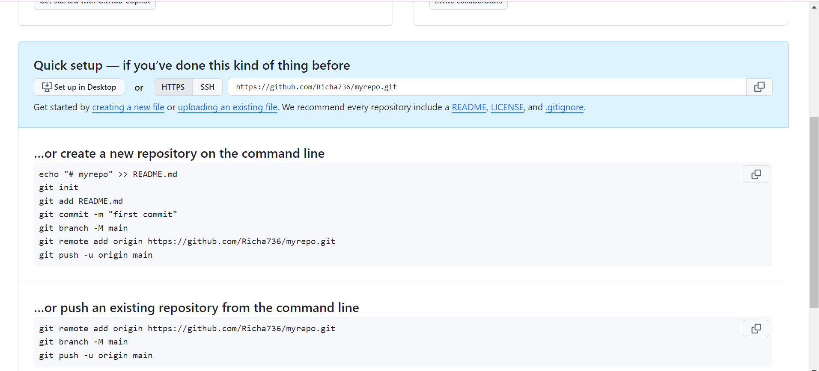

Slide 10
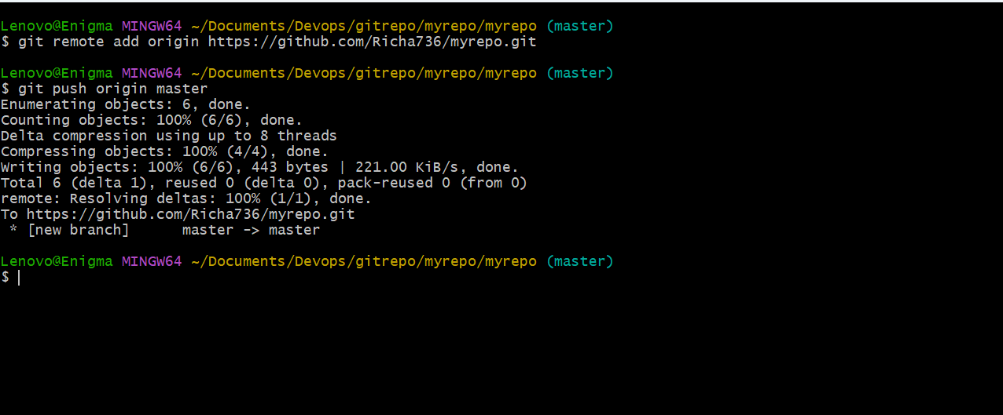
Paste the url create object for eg origin authenticate yourself by signing in the github then continue

Slide 11
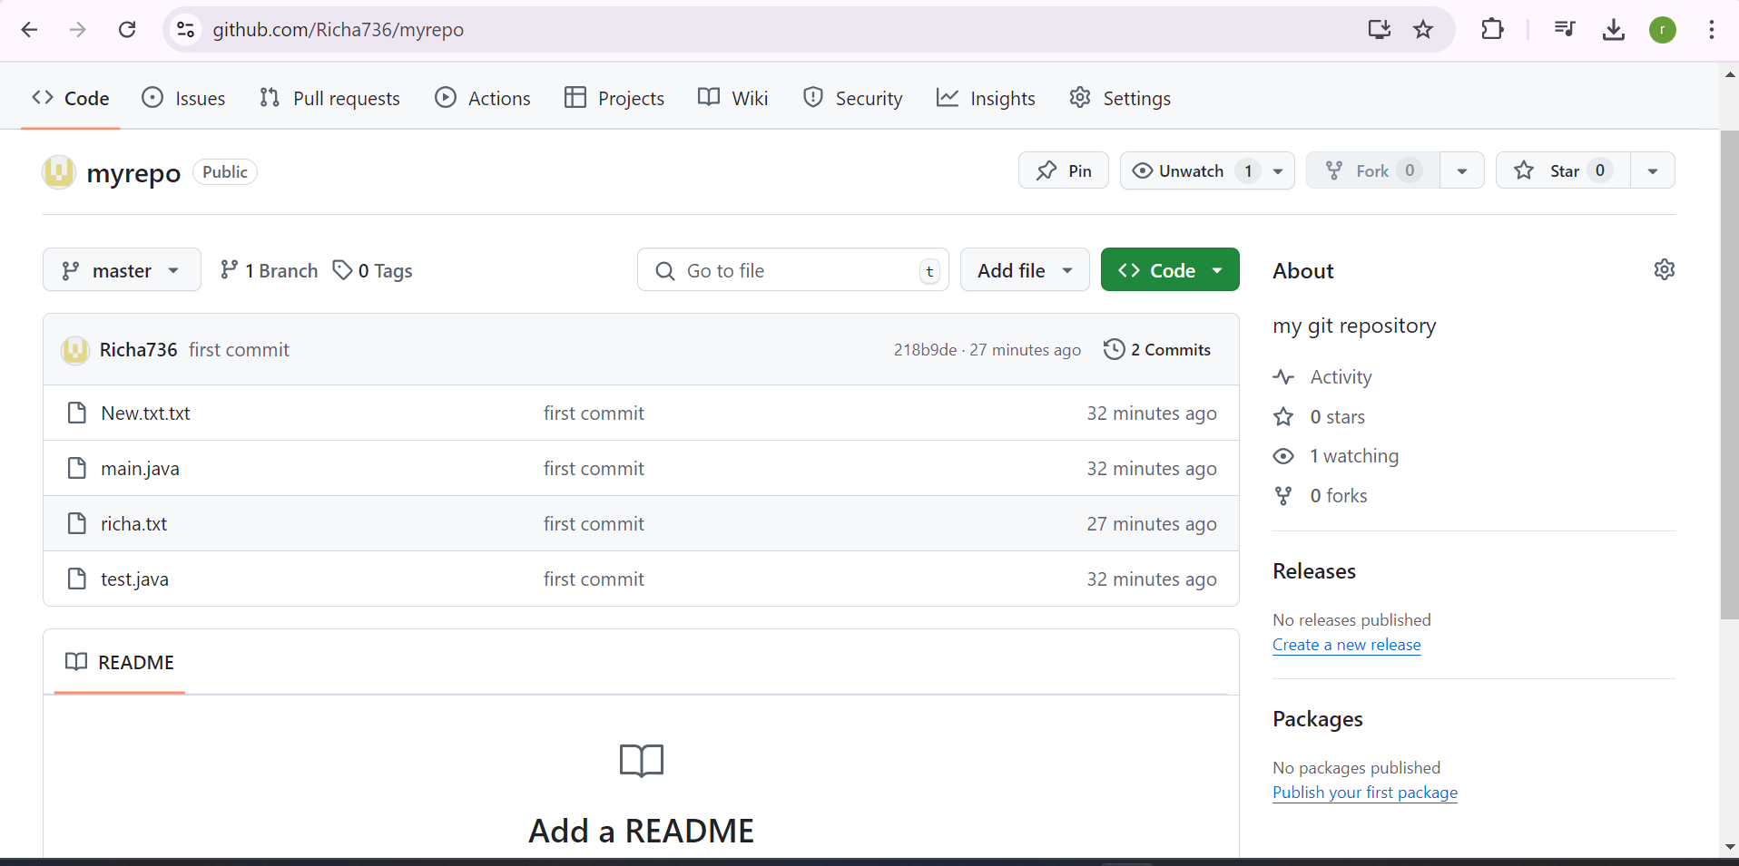

Slide 12
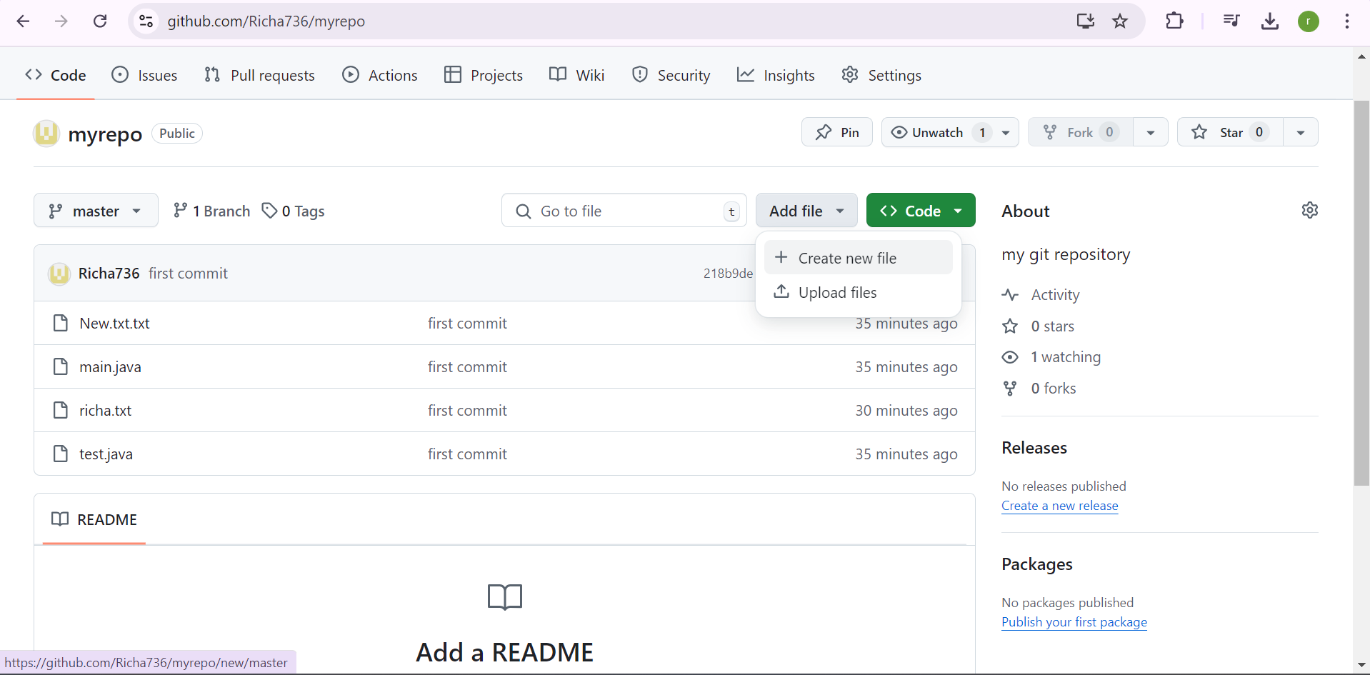
If I want to create new file in remote repository will it be created automatically in local repository lets see:

Slide 13
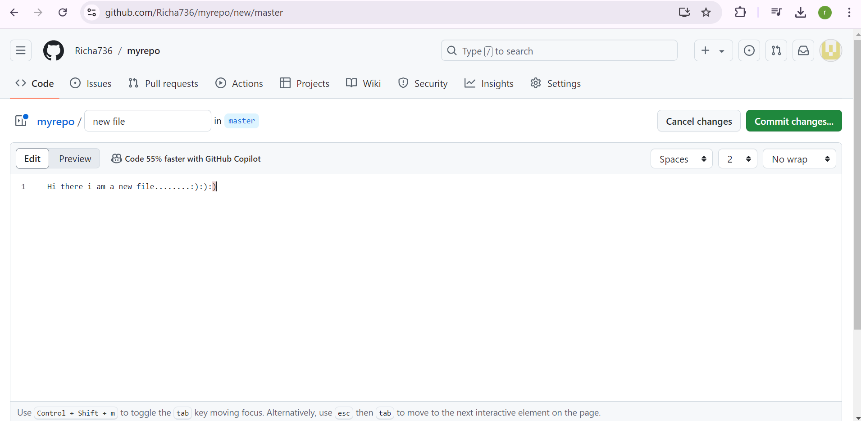

Slide 14
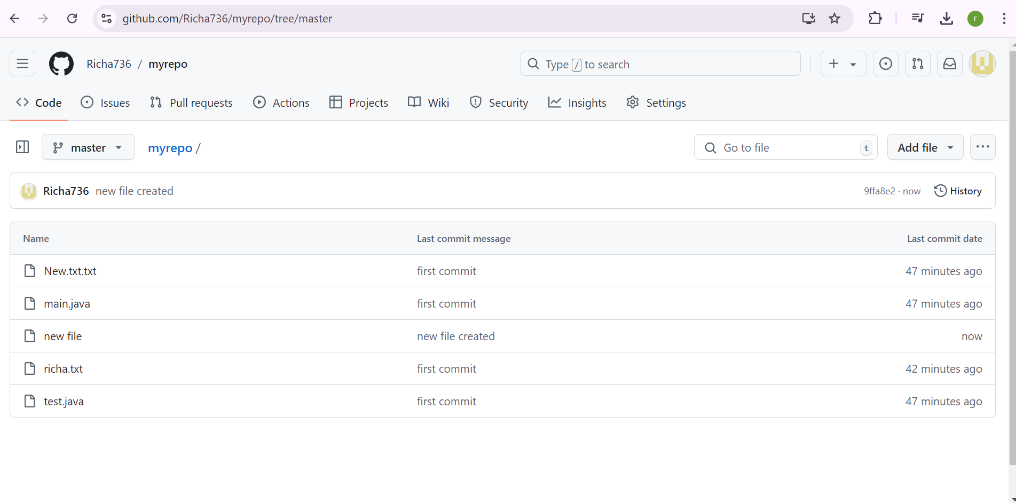

Slide 15
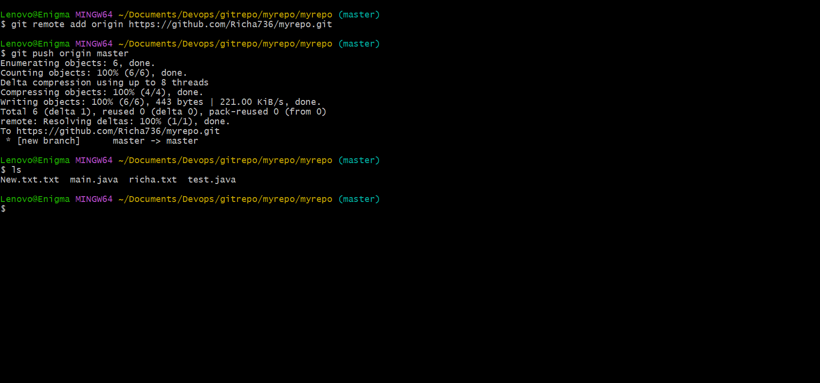
Local repository no new file added

Slide 16
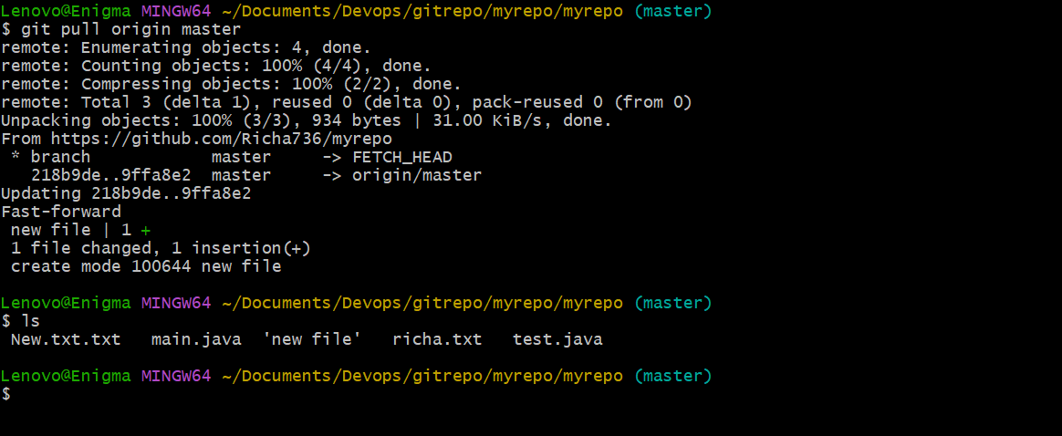
Now we can see the new file in the local repository also.

Slide 17

To come out of the myrepo diriectory

Slide 18
Create a new repository devops-new-
Clone the link

Slide 19
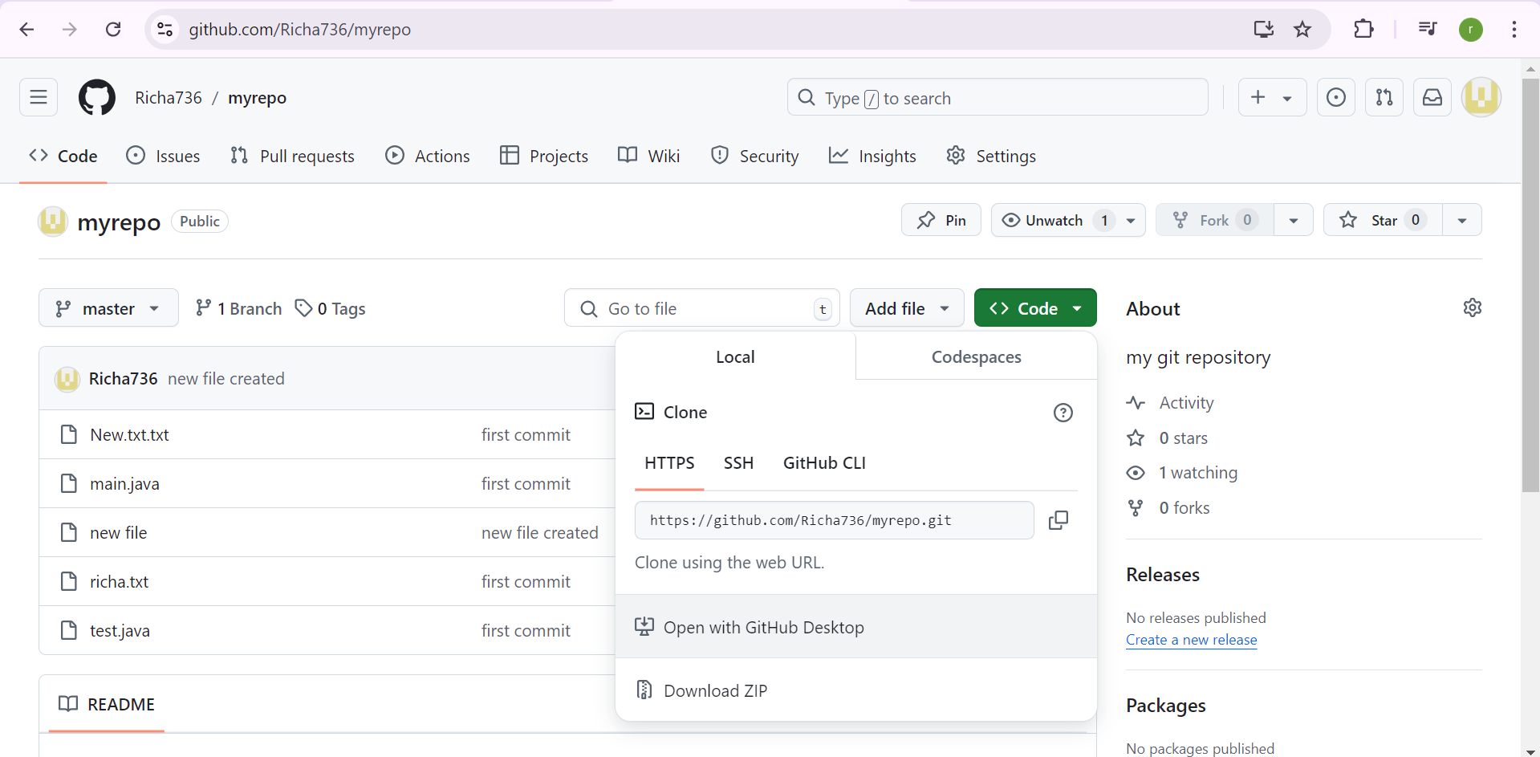

Slide 20
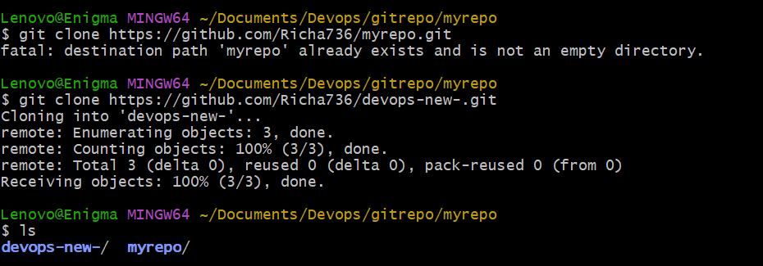

Slide 21


Slide 22
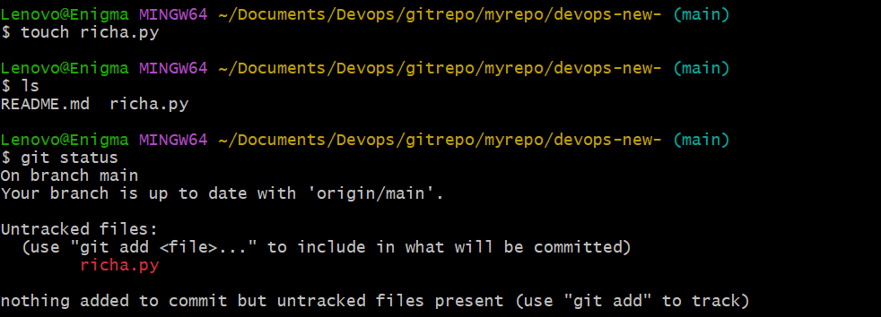

Slide 23


Slide 24
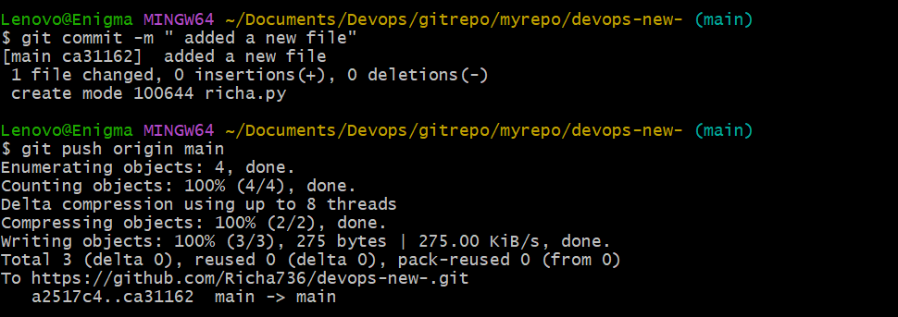

Slide 25
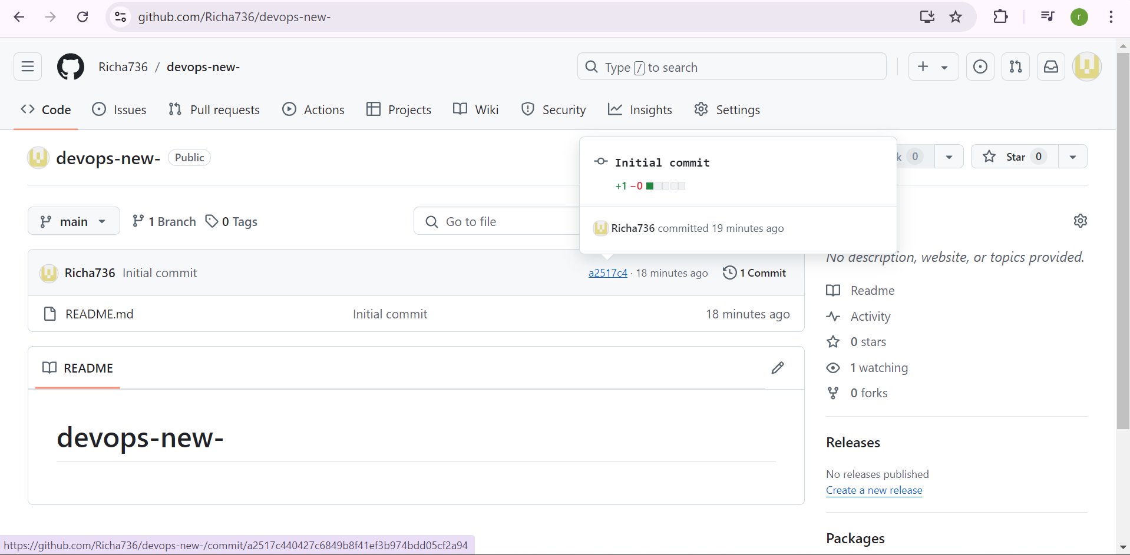

Slide 26
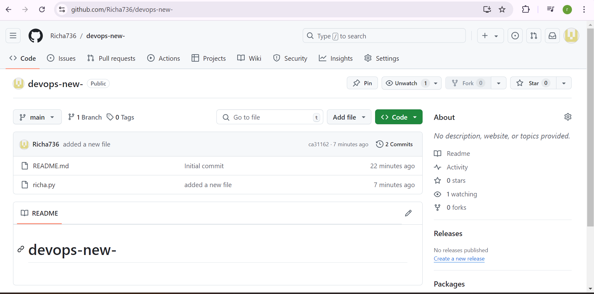

Slide 27
If not able to collaborate :wq if editor window open skip and write :wq

Slide 28
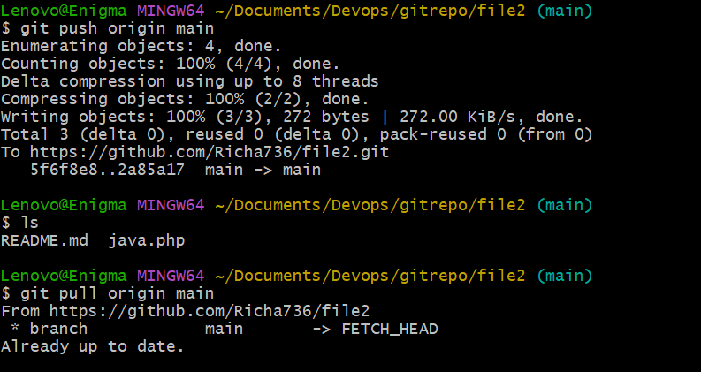

Slide 29
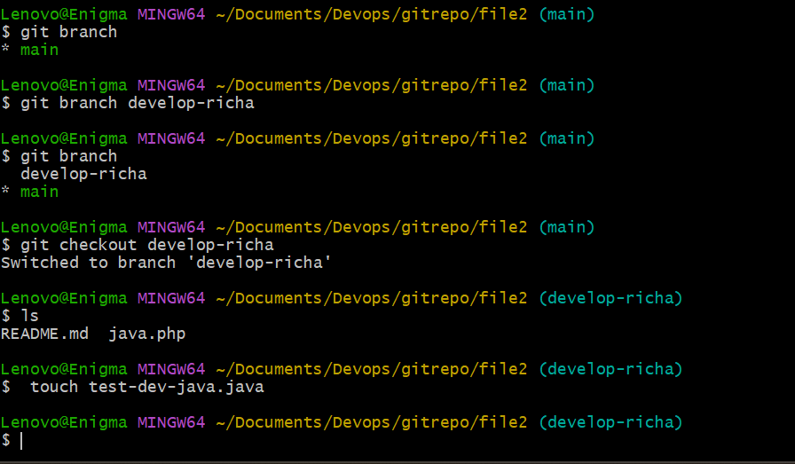

Slide 30
Vi java.php
Enter the text in the file as new window will open

Slide 31


Slide 32
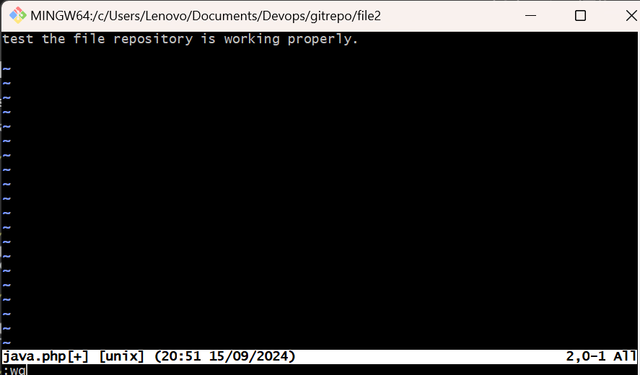

Slide 33
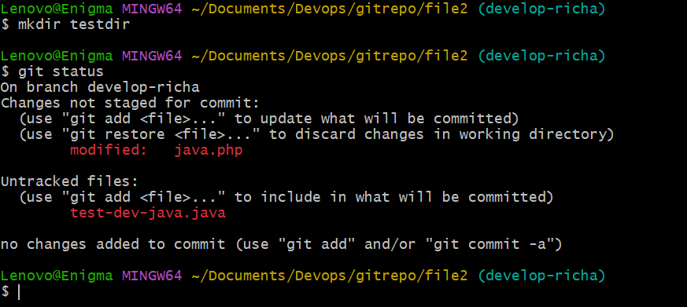

Slide 34
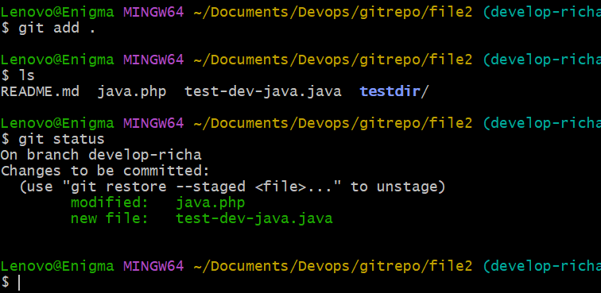

Slide 35


Slide 36
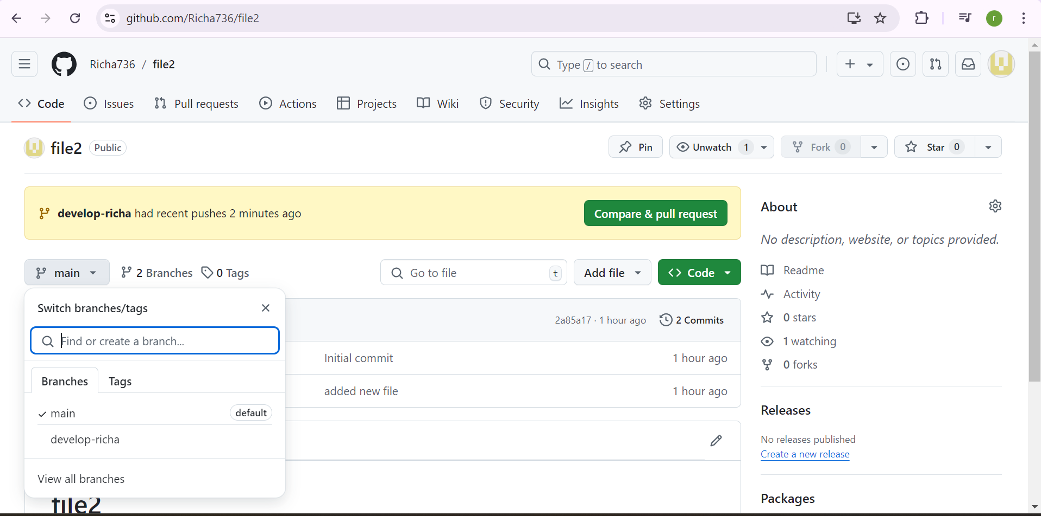

Slide 37
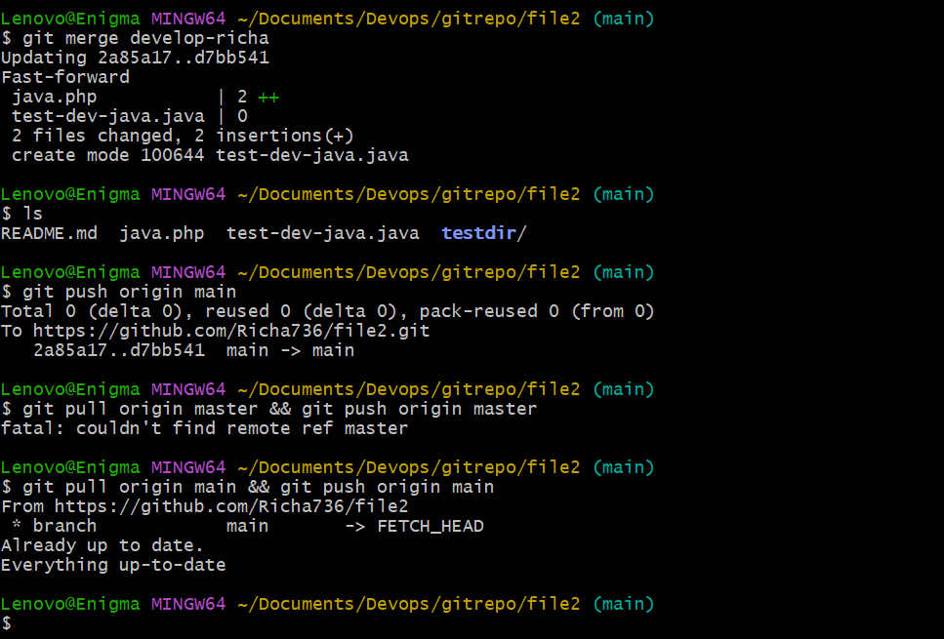
Merging branch

Slide 38
